Slide 1


Viettel Churn Prediction POC Methodology and Update
21/12/2016

Slide 2
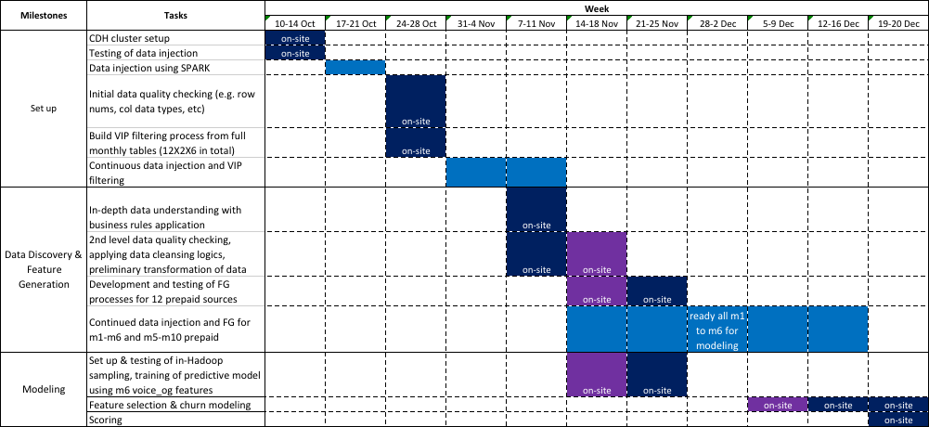
Sequence of Events & Timeline

Slide 3
* Part I: Data Discovery & Feature Generation

Slide 4
1. Voice_og
Raw info: Details of each and every og call
Tags: POD, Daytype, location (province & district), diagnostics, og_call_to, QualityCall, WeeksBeforeLastDate
Features generated (per subs):
Number of calls overall
Total call duration overall
Average call duration
No of distinct province
No of distinct district
No of distinct to_phone_num
No of distinct imei
Total call duration by POD
Max call duration by POD
Avg call duration by POD
Total no. of calls by POD
Total no. of calls by QualityCall (Y/N)
Total no. of calls by og-call-to
Avg call duration by og-call-to
Total no. of calls by DayType
Avg call duration by DayType
Total no. of calls by wfld
Avg call duration by wfld
Number of dropped calls overall

Slide 5
2. Voice_ic
Raw info: Details of each and every ic call
Tags: POD, Daytype, location (province & district), ic_call_from, QualityCall, WeeksBeforeLastDate
Features generated:
Number of calls overall
Total call duration overall
Average call duration
No. of distinct from_phone_num
Total call duration by POD
Max call duration by POD
Avg call duration by POD
No. of call by POD
No. of call by QualityCall
Avg call duration by QualityCall
No. of call by ic_call_from
Avg call duration by ic_call_from
No. of call by Daytype
Avg call duration by Daytype
No. of call by wfld
Avg call duration by wfld

Slide 6
3. Sms_og
Raw info: Details of each and every og sms
Tags: POD, Daytype, og_sms_to, WeeksBeforeLastDate
Features generated:
Number of sms overall
Number of distinct to_phone_num
Number of sms by og_sms_to
Number of sms by Daytype
Number of sms by wfld
Number of sms by POD

Slide 7
4. Sms_ic
Raw info: Details of each and every ic sms
Tags: POD, Daytype, ic_sms_from, WeeksBeforeLastDate
Features generated:
Number of sms overall
Number of distinct from_phone_num
Number of sms by ic_sms_from
Number of sms by Daytype
Number of sms by wfld
Number of sms by POD

Slide 8
5. Gprs
Raw info: Details of each and every data connection session
Tags: POD, Daytype, WeeksBeforeLastDate
Features generated:
No. of data sessions
Total up-down-volume
Average volume per session
Max session volume
Min session volume
Std. dev. In session volume
Total volume by pod
Max volume by pod
Avg volume by pod
Total volume by daytype
Max volume by daytype
Avg volume by daytype
Total volume by wfld
Avg volume by wfld
Max volume by wfld

Slide 9
6. Tot_charge_daily
Raw info: Daily charges by categories
Tags: Daytype
Features generated:
Number of days that charges were incurred
Total org charges
Ratio of total org charges by daytype
Ratio of total voice org charge (over total org charges)
Ratio of total sms org charge
Ratio of total data org charge
Ratio of total mms org charge
Subscribed data pkg (Y/N)
Ratio of total vas_voice org charge
Ratio of total vas_sms org charge
Ratio of total vas_data org charge
Ratio of total vas_others org charge
Ratio of total org charges (over total charges)
Total RS charges
Total RV charges
Total free voice duration
Total free sms times
Total free data volume

Slide 10
7. Topup
Raw info: Details of each and every balance topup
Tags: Daytype
Features generated:
Total count of refill times
Total topup amount
Maximum amount after topup
Minimum amount before topup
Maximum refill amount
Avg refill amount
Avg amount after topup
Avg amount before topup
No. of distinct province topup is done
No. of distinct district topup is done
Count of refill times by Daytype
Total topup amount by daytype
Ratio of refill times by daytype
Ratio of refill amount by daytype
Refill_diff_province (Y/N)
Refill_diff_district (Y/N)

Slide 11
8. Account2_day
Raw info: Daily account balance for each subs
Tags:
Features generated:
Min basic account balance
Max basic account balance
Avg basic account balance
Std dev. basic account balance
Avg promotion account balance

Slide 12
9. Dailyfee
Raw info: Records of each and every data package fee deduction.
Tags:
Features generated:
Level of account balance after each dailyfee deduction (Low/OK/NA)

Slide 13
10. Vas_cdr_day
Raw info: Details of each and every vas subscription/usage
Tags: chargeable_vas (charge_type = 1), vas_type, non_chargeable_vas (charge_type = -1 and total_charge < 0)
Features generated:
Total count of chargeable vas
Total count of non-chargeable vas (e.g. ung thien)
Total count of each chargeable vas by vas_type

Slide 14
11. Home_acc
Raw info: Details of each subs most frequent location everyday
Tags:
Features generated:
Number of distinct home locations over the month

Slide 15
12. Pre-subs
Raw info: Details of each and every subs
Tags:
Features extracted:
Age
Sex (3 categories)
Data package subscribed
Dcom flag (1 or 0)

Slide 16
* Part II: Feature Selection & Modeling
Narrow Down to the Best Attributes from Each Data Source
Train and Validate a Churn Model
Results – Confusion Matrix
Important Attributes
Baseline Models
Top Decile Analysis

Slide 17
Selection of the Best Attributes from Each Data Source
Data Source | Initial Number of Attributes
Voice OG | 286
Voice IC | 268
SMS OG | 92
SMS IC | 92
GRPS | 196
Total_Charge | 108
TOPUP | 120
Account2 | 30
DailyFee | 6
VAS | 66
Home | 6
SUBS | 4
Total | 1274

Slide 18
Selection of the Best Attributes from Each Data Source
Data Source | Initial Number of Attributes | New Number of Attributes
Voice OG | 286 | ?
Voice IC | 268 | ?
SMS OG | 92 | ?
SMS IC | 92 | ?
GRPS | 196 | ?
Total_Charge | 108 | ?
TOPUP | 120 | ?
Account2 | 30 | ?
DailyFree | 6 | ?
VAS | 66 | ?
Home | 6 | ?
SUBS | 4 | ?
Total | 1274 | ?

Slide 19
Selection of the Best Attributes from Each Data Source
Individual data source (modeling table) is used to fit a spark Decision Tree
Here we used a deep Decision Tree (high complexity) to overfit the training data with the aim to determine all possible attributes which are relevant to the churn outcome
Extract the important attributes from each each Decision Tree in order
The aim is to reduce the full set of 1270 variables into a smaller subset for the faster model training process

Slide 20
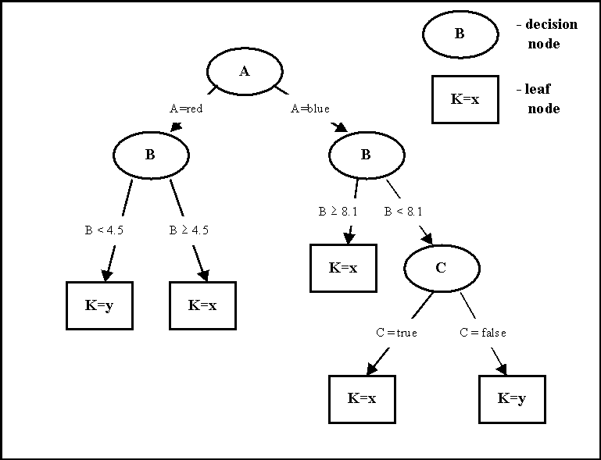
Selection of the Best Attributes from Each Data Source
What is a decision tree ?
A decision tree can be used to classify an new example by starting at the root of the tree and moving through it until a leaf node, which provides the classification of the instance
Each decision node is an attribute which will be split into two branches
Decision tree searches through the attributes of the training data and extracts the attribute that best separates the given examples. If the attribute perfectly classifies the training sets then the decision tree stops

Slide 21
Selection of the Best Attributes from Each Data Source
What is a decision tree ?
Rules:
If A = red
If B >=4.5
K = x (80%)
If B <4.5
K = y (66%)
If A = blue
If B >=8.1
K = x (77%)
If B <8.1
If C =true
K = x (55%)
If C =false
K = y (90%)

Slide 22
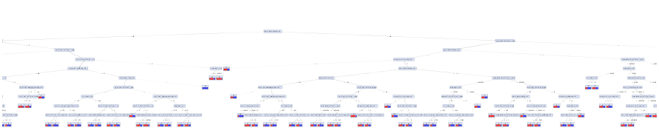
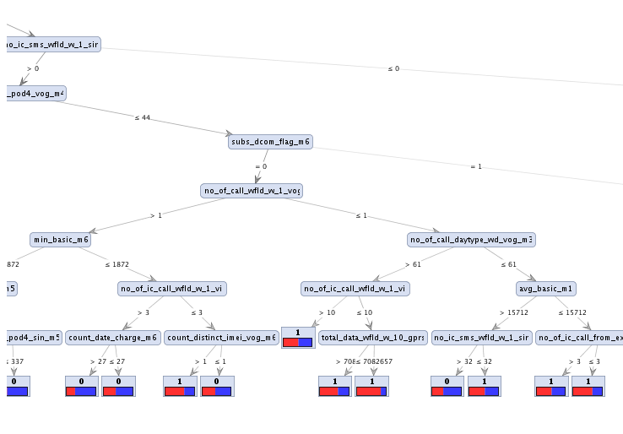
Selection of the Best Attributes from Each Data Source

Slide 23
Selection of the Best Attributes from Each Data Source
Most Important Attributes
2nd Most Important Attributes
3rd Most Important Attributes
4th Most Important Attributes
5th
6th
7th

Slide 24
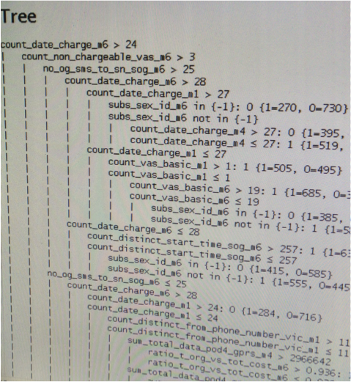
Selection of the Best Attributes from Each Data Source

Slide 25
Selection of the Best Attributes from Each Data Source
Data Source | Initial Number of Attributes | New Number of Attributes
Voice OG | 286 | 210
Voice IC | 268 | 90
SMS OG | 92 | 64
SMS IC | 92 | 68
GRPS | 196 | 92
Total_Charge | 108 | 44
TOPUP | 120 | 57
Account2 | 30 | 30
DailyFree | 6 | 6
VAS | 66 | 32
Home | 6 | 6
SUBS | 4 | 4
Total | 1274 | 703

Slide 26
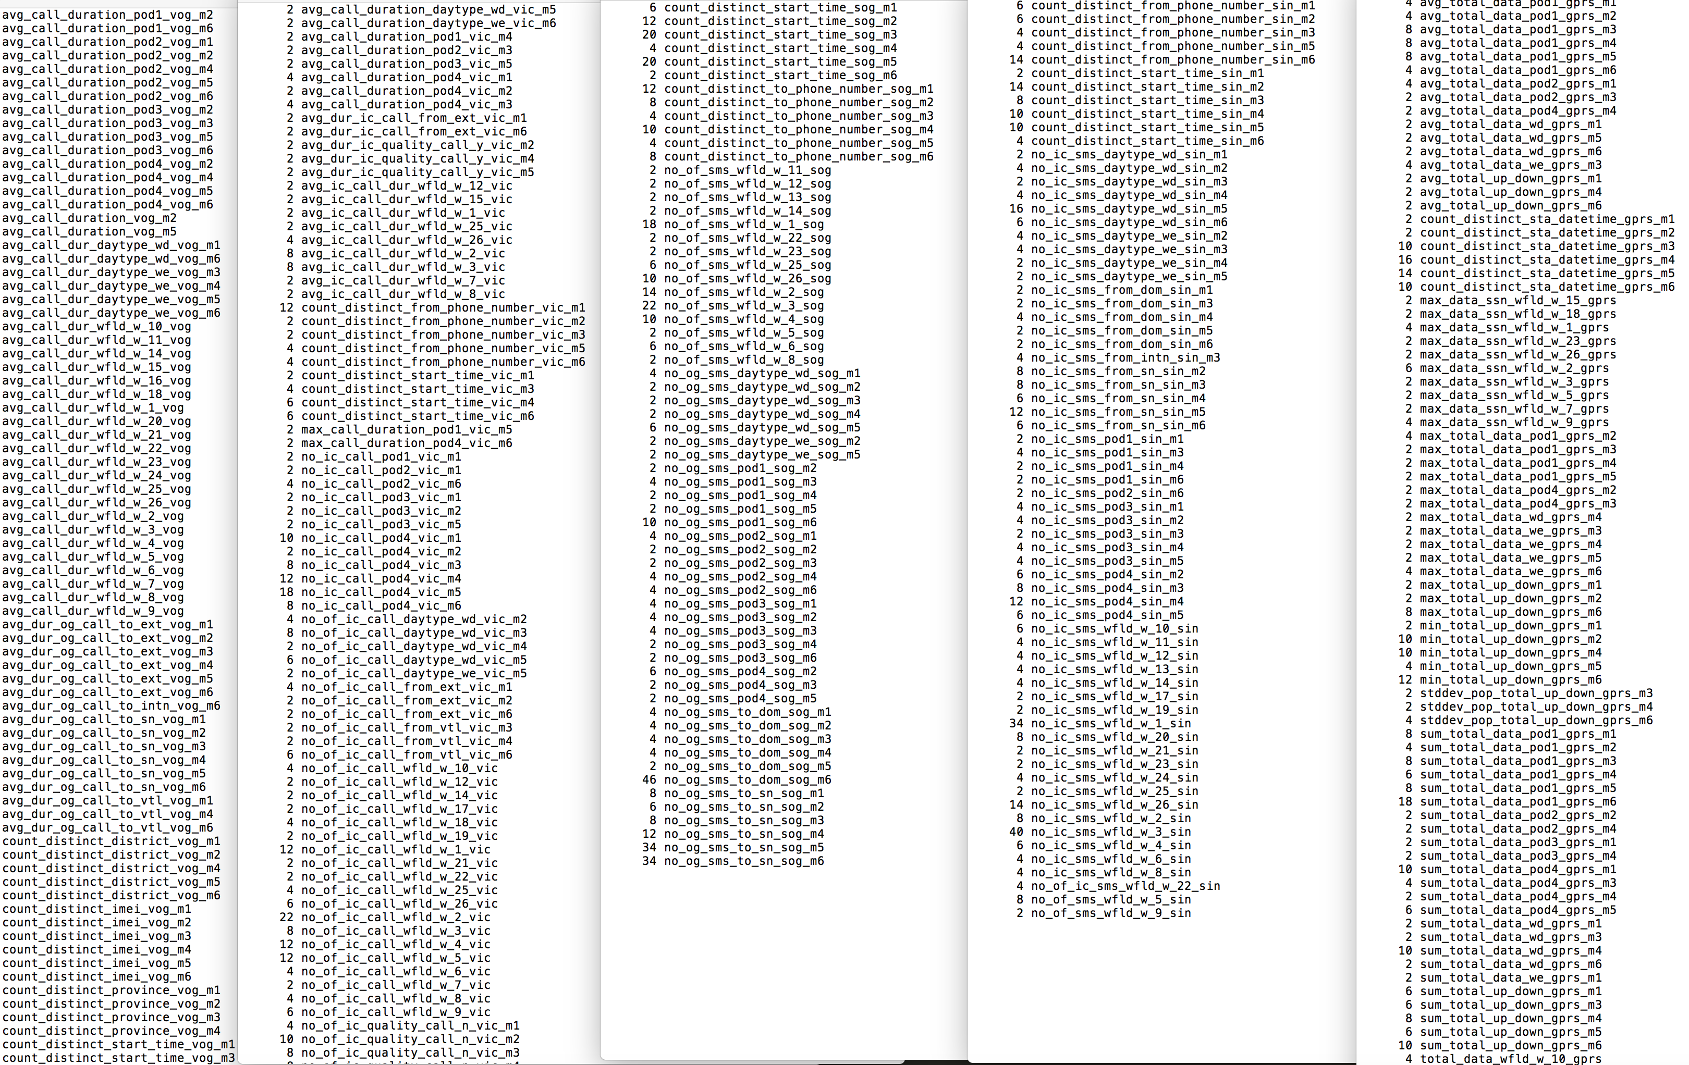
Selection of the Best Attributes from Each Data Source
Voice OG
Voice IC
SMS OG
SMS IC
GPRS

Slide 27
Train and Validate a Churn Model
Among the ~4.5 million customers, we randomly sampled ~500,000 non-churn customers and combined with it with the known ~500,000 churners, we have the formation of a machine learning modeling dataset of ~1 million customers
Split validation process which basically splits the ~1 million customers into 80% and 20%
80% of the customers and their respective attributes are used for training a decision tree
20% of the customer are unseen in the 80% dataset and are used for testing the decision tree once it is trained
The decision tree is trained using 703 attributes

Slide 28
Results – Confusion Matrix
Validation of the Testing Data Set (20% of Total)
*Using score cutoff of 0.455 | true (No Churn) | true (Churn) | Precision
predict (No Churn) | 318587 | 113905 | 0.74
predict (Churn) | 83809 | 280781 | 0.77
Recall | 0.79 | 0.71
Validation of the Training Data Set (80% of Total)
*Using score cutoff of 0.455 | true (No Churn) | true (Churn) | Precision
predict (No Churn) | 79328 | 28895 | 0.73
predict (Churn) | 21117 | 70696 | 0.77
Recall | 0.79 | 0.71

Slide 29
Important Attributes
Ranking | Attribute |  | Description
1 | count_date_charge_m6 |  | number of days subscriber was incurred a charge on month 6
2 | count_non_chargeable_vas_m6 |  | number of non-chargeable (e.g. credit borrowing) vas used on month 6
2 | no_of_call_wfld_w_1_vog |  | number of calls made on week 1
3 | no_og_sms_to_sn_sog_m6 |  | number of sms sent to short numbers on month 6
3 | total_data_wfld_w_1_gprs |  | total data used on week 1
4 | max_data_ssn_wfld_w_1_gprs |  | volume of the single largest data session on week 1
4 | min_basic_m6 |  | minimum end-of-day basic account balance over everyday on month 6
4 | no_ic_sms_wfld_w_1_sin |  | number of sms received on week 1
4 | subs_dcom_flag_m6 |  | whether subscriber has registered to use dongle
5 | avg_promotion_m6 |  | average end-of-day promotion account balance over everyday on month 6
5 | count_date_charge_m1 |  | number of days subscriber was incurred a charge on month 1
5 | count_distinct_from_phone_number_vic_m1 |  | number of distinct incoming phone numbers on month 1
5 | count_distinct_start_time_sog_m6 |  | number of sms sent on month 6
5 | max_basic_m6 |  | maximum end-of-day basic account balance over everyday on month 6
5 | no_og_call_pod4_vog_m4 |  | number of calls made between 6pm and 12am on month 4
6 | count_vas_basic_m1 |  | number of basic vas used on month 1
6 | max_amount_after_m6 |  | maximum account $ available after topup(s) on month 6
6 | min_basic_m5 |  | minimum end-of-day basic account balance over everyday on month 5
6 | no_of_ic_call_wfld_w_1_vic |  | number of calls received on week 1
6 | subs_sex_id_m6 |  | subscriber's gender
6 | sum_refill_amount_m6 |  | total topup amount on month 6
7 | count_date_charge_m4 |  | number of days subscriber was incurred a charge on month 4
7 | count_non_chargeable_vas_m5 |  | number of non-chargeable (e.g. credit borrowing) vas used on month 5
7 | count_vas_basic_m6 |  | number of basic vas used on month 6
7 | no_of_call_daytype_wd_vog_m3 |  | number of calls made on weekdays in month 3
7 | no_of_call_daytype_wd_vog_m6 |  | number of calls made on weekdays in month 6
7 | no_of_call_wfld_w_4_vog |  | number of calls made on week 4
7 | sum_total_data_pod4_gprs_m4 |  | total data used between 6pm to 12am on month 4
7 | sum_v_free_duration_m6 |  | total free voice minutes used on month 6
7 | total_data_wfld_w_3_gprs |  | total data used on week 3
8 | avg_amount_before_m6 |  | average account $ available before topup(s) on month 6
8 | avg_call_dur_wfld_w_20_vog |  | average outgoing call duration on week 20
8 | avg_call_dur_wfld_w_7_vog |  | average outgoing call duration on week 7
8 | avg_ic_call_dur_wfld_w_1_vic |  | average incoming call duration on week 1
8 | count_date_charge_m5 |  | number of days subscriber was incurred a charge on month 5
8 | max_data_ssn_wfld_w_3_gprs |  | volume of the single largest data session on week 3
8 | no_of_call_wfld_w_5_vog |  | number of calls made on week 5
8 | no_og_sms_pod4_sog_m3 |  | number of sms sent between 6pm and 12am on month 3
8 | no_og_sms_to_sn_sog_m3 |  | number of sms sent to short numbers on month 3
8 | ratio_t_org_vs_tot_cost_m6 |  | ratio of total "org" charges againts overall ("org" + "promo") charges on month 6
9 | avg_basic_m1 |  | average end-of-day basic account balance over everyday on month 1
9 | no_of_call_wfld_w_3_vog |  | number of calls made on week 3
9 | no_og_sms_pod3_sog_m6 |  | number of sms sent between 12pm and 6pm on month 6
9 | ratio_t_org_cost_vas_others_m5 |  | ratio of vas_others charges againts total "org" charges on month 5
9 | sum_t_org_cost_m4 |  | total "org" charges on month 4

Slide 30
Baseline Models
Logistic Regression:
Validation of the Testing Data Set (20% of Total)
*Using score cutoff of 0.6215 | true (No Churn) | true (Churn) | Precision
predict (No Churn) | 63003 | 20296 | 0.76
predict (Churn) | 37982 | 78469 | 0.67
Recall | 0.62 | 0.79
Naïve Bayes:
Validation of the Testing Data Set (20% of Total)
*Using score cutoff of 0.6215 | true (No Churn) | true (Churn) | Precision
predict (No Churn) | 81614 | 73281 | 0.53
predict (Churn) | 19548 | 23782 | 0.55
Recall | 0.81 | 0.25

Slide 31
How to make use of this model ? : Top Decile Analysis
 |  |  |  |  |  | (Total = 200,036)
Bin Index | Sum Churners Count | Avg Propensity Score | Min Propensity Score | Customers # | Accum Churners Count | Accum Customers Count | Churn Rate | Recall Rate
1 | 9372 | 0.937 | 0.937 | 10002 | 9372 | 10002 | 94% | 9%
2 | 9368 | 0.937 | 0.937 | 10002 | 18740 | 20004 | 94% | 19%
3 | 9414 | 0.937 | 0.937 | 10002 | 28154 | 30006 | 94% | 28%
4 | 9275 | 0.927 | 0.846 | 10002 | 37429 | 40008 | 94% | 38%
5 | 8215 | 0.822 | 0.734 | 10002 | 45644 | 50010 | 91% | 46%
6 | 6970 | 0.701 | 0.656 | 10002 | 52614 | 60012 | 88% | 53%
7 | 6501 | 0.645 | 0.625 | 10002 | 59115 | 70014 | 84% | 59%
8 | 5670 | 0.563 | 0.547 | 10002 | 64785 | 80016 | 81% | 65%
9 | 5084 | 0.506 | 0.458 | 10002 | 69869 | 90018 | 78% | 70%
10 | 4588 | 0.452 | 0.451 | 10002 | 74457 | 100020 | 74% | 75%
11 | 4303 | 0.432 | 0.384 | 10002 | 78760 | 110022 | 72% | 79%
12 | 3692 | 0.365 | 0.319 | 10002 | 82452 | 120024 | 69% | 83%
13 | 2938 | 0.289 | 0.285 | 10002 | 85390 | 130026 | 66% | 86%
14 | 2796 | 0.283 | 0.247 | 10002 | 88186 | 140028 | 63% | 89%
15 | 2481 | 0.245 | 0.242 | 10002 | 90667 | 150030 | 60% | 91%
16 | 2010 | 0.194 | 0.17 | 10002 | 92677 | 160032 | 58% | 93%
17 | 1751 | 0.17 | 0.17 | 10002 | 94428 | 170034 | 56% | 95%
18 | 1747 | 0.17 | 0.17 | 10002 | 96175 | 180036 | 53% | 97%
19 | 1729 | 0.17 | 0.17 | 10002 | 97904 | 190038 | 52% | 98%
20 | 1687 | 0.166 | 0.01 | 9998 | 99591 | 200036 | 50% | 100%
 | 99591

Slide 32
Top Decile Analysis
Pick 50k customers, select this cutoff as your selection criterion
 |  |  |  |  |  | (Total = 200,036)
Bin Index | Sum Churners Count | Avg Propensity Score | Min Propensity Score | Customers # | Accum Churners Count | Accum Customers Count | Churn Rate | Recall Rate
1 | 9372 | 0.937 | 0.937 | 10002 | 9372 | 10002 | 94% | 9%
2 | 9368 | 0.937 | 0.937 | 10002 | 18740 | 20004 | 94% | 19%
3 | 9414 | 0.937 | 0.937 | 10002 | 28154 | 30006 | 94% | 28%
4 | 9275 | 0.927 | 0.846 | 10002 | 37429 | 40008 | 94% | 38%
5 | 8215 | 0.822 | 0.734 | 10002 | 45644 | 50010 | 91% | 46%
6 | 6970 | 0.701 | 0.656 | 10002 | 52614 | 60012 | 88% | 53%
7 | 6501 | 0.645 | 0.625 | 10002 | 59115 | 70014 | 84% | 59%
8 | 5670 | 0.563 | 0.547 | 10002 | 64785 | 80016 | 81% | 65%
9 | 5084 | 0.506 | 0.458 | 10002 | 69869 | 90018 | 78% | 70%
10 | 4588 | 0.452 | 0.451 | 10002 | 74457 | 100020 | 74% | 75%
11 | 4303 | 0.432 | 0.384 | 10002 | 78760 | 110022 | 72% | 79%
12 | 3692 | 0.365 | 0.319 | 10002 | 82452 | 120024 | 69% | 83%
13 | 2938 | 0.289 | 0.285 | 10002 | 85390 | 130026 | 66% | 86%
14 | 2796 | 0.283 | 0.247 | 10002 | 88186 | 140028 | 63% | 89%
15 | 2481 | 0.245 | 0.242 | 10002 | 90667 | 150030 | 60% | 91%
16 | 2010 | 0.194 | 0.17 | 10002 | 92677 | 160032 | 58% | 93%
17 | 1751 | 0.17 | 0.17 | 10002 | 94428 | 170034 | 56% | 95%
18 | 1747 | 0.17 | 0.17 | 10002 | 96175 | 180036 | 53% | 97%
19 | 1729 | 0.17 | 0.17 | 10002 | 97904 | 190038 | 52% | 98%
20 | 1687 | 0.166 | 0.01 | 9998 | 99591 | 200036 | 50% | 100%
 | 99591
Recall ~60k churners, select this cutoff as your selection criterion

Slide 33
Part III: Feature Selection & Modeling (cont’d)
Cluster subscribers to 4 groups by usage behavior
630k (200k for each cluster, 30k for cluster2, randomly sampled) of overall 4.5 mil subs used for modeling & validation, at 70:30 split
Follows the original class distribution in the overall population (e.g. cluster0 at ~90:10). No up/down sampling
One selected set of features for each cluster
One model for each cluster

Slide 34
Model Training
Step 0: Reduce the attributes number from 1274 to 704
By training a decision tree for each data source
Trim the low levels and extract the nodes from upper levels

Slide 35
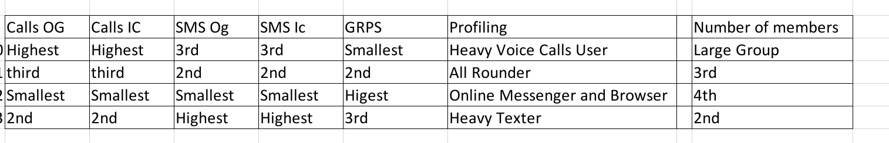
Model Training
Step 1: Cluster the customers into 4 groups using k-means clustering
Using several attributes related to: vog, vic, sog, sin, and gprs
Found 4 clusters and profile the subs into 4 usage groups
Saved the k-means model to later apply on scoring set
Notes:
Scoring:
Cluster0 – 2920713
Cluster1 – 383267
Cluster2 – 80199
Cluster3 - 665532

Slide 36
Model Training
Step 2: Find the optimal ratio of split validation
The proposed approach is simple, we will keep a fixed 20% of the test set, and then vary the training set from 80% to 70% to 60%, gradually down to 20% (decrement of 10%) and observe the validation accuracy. At one stage, let's say at 40%, the model will have a steep drop in performance, hence the optimal ratio of split validation is 40 : 20 which is equivalent to 67% : 33 %

Slide 37
Model Training
Step 3: Find the optimal sample size for training (not 4.5 million)
The proposed approach is simple, for model training, sample 10% of 4.5 million, followed by 20% and so forth (increment of 10%), for each round, evaluate the model accuracy, at one stage, the accuracy will reach plateau and that's the optimal size

Slide 38
Model Training
Step 4: Features Selection
Run (in-memory) forward selection for each cluster to keep maximum 50 features
Results return maximum of 13 attributes for one of the clusters, the number is not ideal, so we also fitted the samples of each cluster to a decision tree
The important features from the tree is extracted and combined with the attributes extracted from features selection
Result: 32 atts for c0; 37 atts for c1; 15 atts for c2; 31 atts for c3

Slide 39
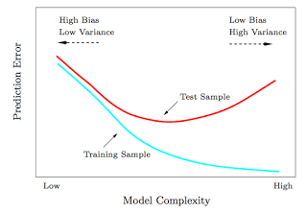
Model Training
Step 5: Determine the optimum model parameters
First, will train a decision tree, using different complexities and test the models
The best model complexity is selected based on the test set’s AUC value of a split validation test
This optimal complexity is used in the following model training process with random forest
* Ran it on cluster0 (See cluster0.log)
Found that best parameters set is
Depth = 20
Min leaf size = 4
Min gain = 0.0145

Slide 40
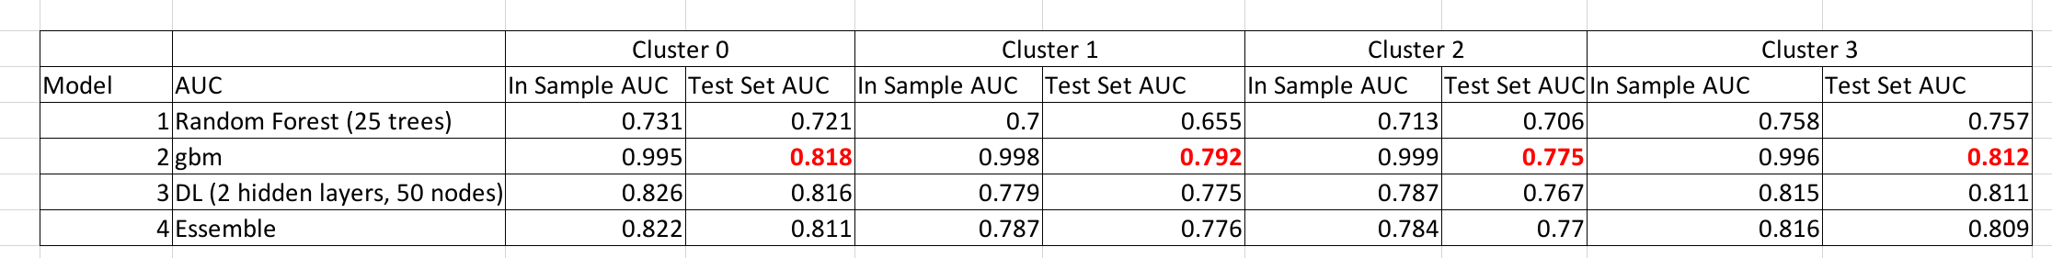
Model Training
Step 6: Selecting the best model
Train & evaluate deep learning, random forest (the tree parameters follow the values described in last slide), gbt, & ensemble models
Trained ensemble model using confidence score averaging method
Check the AUC (training set & test set) for each model
The best performing model is found to be gbt model
Save models for each cluster for scoring

Slide 41
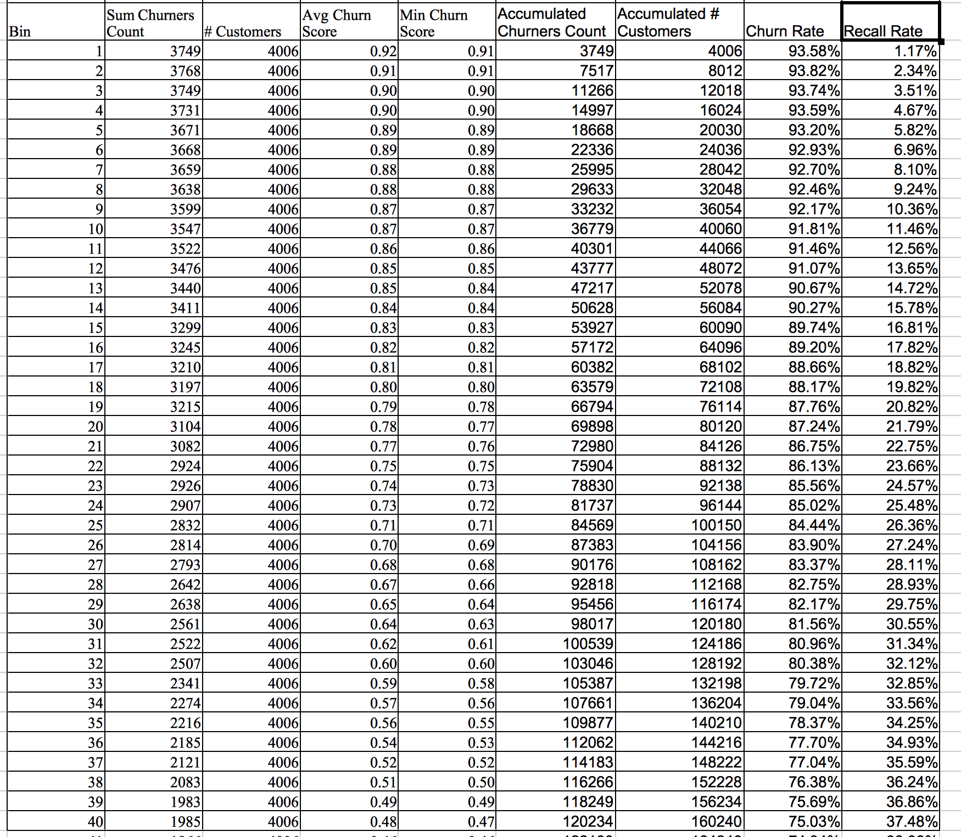
Models Validation (Cluster_0, 3,082,885)

Slide 42
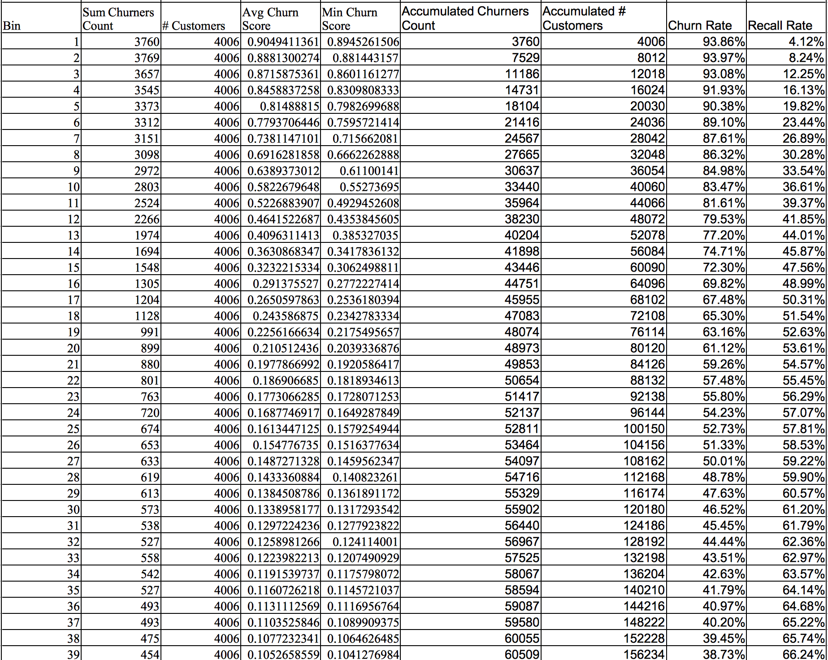
Models Validation (Cluster_3, 823,704 customers)

Slide 43
Model Training
Step 7: Relatively importance variables
Cluster_0
Variable | Relative Importance
no_of_call_wfld_w_1_vog | 1
count_date_charge_m6 | 0.310128
no_ic_sms_wfld_w_1_sin | 0.221237
no_og_call_pod4_vog_m3 | 0.104748
no_og_sms_daytype_wd_sog_m6 | 0.101991
stddev_pop_basic_m2 | 0.098934
no_of_ic_call_wfld_w_1_vic | 0.096735
count_vas_basic_m2 | 0.081468
count_distinct_from_phone_number_sin_m6 | 0.080259
avg_basic_m6 | 0.079227
Cluster_1
Variable | Relative Importance
no_of_call_wfld_w_1_vog | 1
sum_t_org_cost_m6 | 0.470099
count_date_charge_m6 | 0.372676
no_of_ic_call_wfld_w_1_vic | 0.243083
no_ic_sms_wfld_w_1_sin | 0.194117
stddev_pop_basic_m2 | 0.190084
no_of_ic_quality_call_y_vic_m3 | 0.182135
no_og_call_pod4_vog_m3 | 0.17144
count_vas_basic_m2 | 0.148611
no_og_sms_pod3_sog_m6 | 0.147593
Cluster_2
Variable | Relative Importance
count_date_charge_m6 | 1
total_data_wfld_w_12_gprs | 0.418361
count_refill_time_m6 | 0.41017
count_chargeable_vas_m5 | 0.387305
sum_call_duration_pod2_vic_m2 | 0.37823
subscribed_data_pkg_m6 | 0.372614
avg_call_duration_daytype_we_vic_m6 | 0.371158
count_non_chargeable_vas_m2 | 0.360878
subs_dcom_flag_m6 | 0.35977
avg_call_dur_wfld_w_21_vog | 0.31966
Cluster_3
Variable | Relative Importance
no_of_call_wfld_w_1_vog | 1
sum_t_org_cost_m6 | 0.224733
total_data_wfld_w_1_gprs | 0.14485
max_basic_m6 | 0.123973
no_of_call_wfld_w_5_vog | 0.100572
no_of_call_wfld_w_24_vog | 0.09493
no_og_sms_to_sn_sog_m3 | 0.09171
no_ic_sms_wfld_w_1_sin | 0.089806
count_distinct_from_phone_number_sin_m2 | 0.08262
avg_refill_amount_m2 | 0.079478

Slide 44
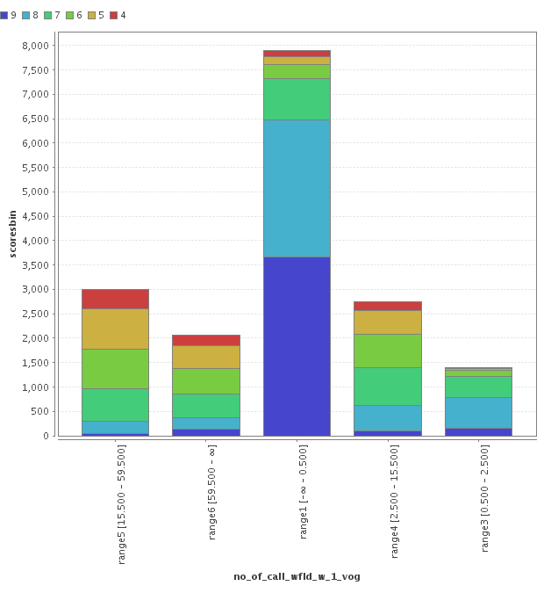
Training
Increasing Risk Rating of Churn
Step 8: Churn Motives (Cluster_0)
Cluster_0
Variable | Relative Importance
no_of_call_wfld_w_1_vog | 1
count_date_charge_m6 | 0.310128
no_ic_sms_wfld_w_1_sin | 0.221237
no_og_call_pod4_vog_m3 | 0.104748
no_og_sms_daytype_wd_sog_m6 | 0.101991
stddev_pop_basic_m2 | 0.098934
no_of_ic_call_wfld_w_1_vic | 0.096735
count_vas_basic_m2 | 0.081468
count_distinct_from_phone_number_sin_m6 | 0.080259
avg_basic_m6 | 0.079227
Discretized no_of_call_wfld_w_1_vog Segments

Slide 45
Training
Increasing Risk Rating of Churn
Step 8: Churn Motives (Cluster_0)
Cluster_0
Variable | Relative Importance
no_of_call_wfld_w_1_vog | 1
count_date_charge_m6 | 0.310128
no_ic_sms_wfld_w_1_sin | 0.221237
no_og_call_pod4_vog_m3 | 0.104748
no_og_sms_daytype_wd_sog_m6 | 0.101991
stddev_pop_basic_m2 | 0.098934
no_of_ic_call_wfld_w_1_vic | 0.096735
count_vas_basic_m2 | 0.081468
count_distinct_from_phone_number_sin_m6 | 0.080259
avg_basic_m6 | 0.079227
81% high risk
60% high risk
* Select no_of_call_wfld_w_1_vog <= 2.5
Discretized no_of_call_wfld_w_1_vog Segments

Slide 46
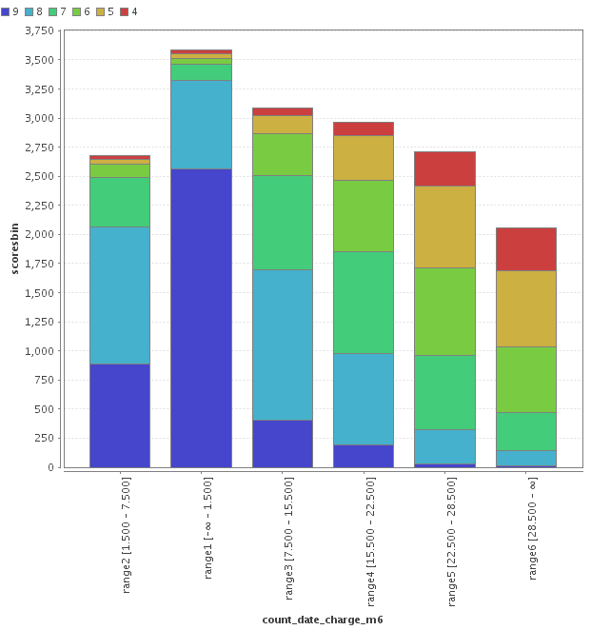
Training
Increasing Risk Rating of Churn
92% high risk
Step 8: Churn Motives (Cluster_0)
Cluster_0
Variable | Relative Importance
no_of_call_wfld_w_1_vog | 1
count_date_charge_m6 | 0.310128
no_ic_sms_wfld_w_1_sin | 0.221237
no_og_call_pod4_vog_m3 | 0.104748
no_og_sms_daytype_wd_sog_m6 | 0.101991
stddev_pop_basic_m2 | 0.098934
no_of_ic_call_wfld_w_1_vic | 0.096735
count_vas_basic_m2 | 0.081468
count_distinct_from_phone_number_sin_m6 | 0.080259
avg_basic_m6 | 0.079227
51% high risk
* Select count_date_charge_m6 <= 7.5
Discretized count_date_charge_m6 Segments

Slide 47
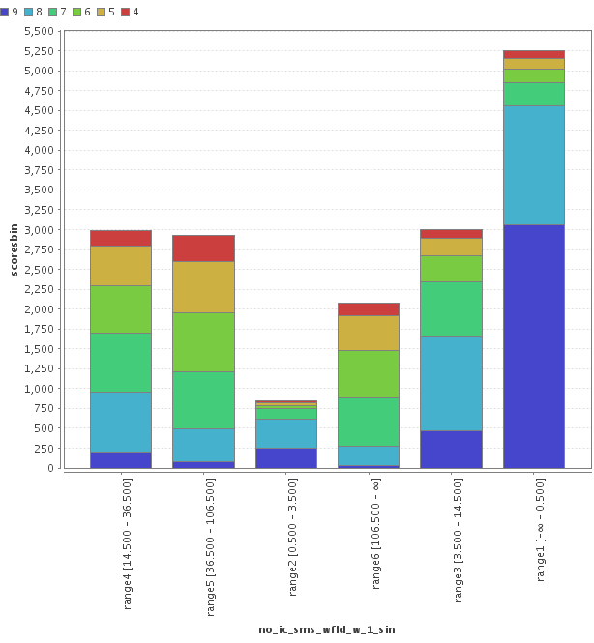
Training
Increasing Risk Rating of Churn
Step 8: Churn Motives (Cluster_0)
Cluster_0
Variable | Relative Importance
no_of_call_wfld_w_1_vog | 1
count_date_charge_m6 | 0.310128
no_ic_sms_wfld_w_1_sin | 0.221237
no_og_call_pod4_vog_m3 | 0.104748
no_og_sms_daytype_wd_sog_m6 | 0.101991
stddev_pop_basic_m2 | 0.098934
no_of_ic_call_wfld_w_1_vic | 0.096735
count_vas_basic_m2 | 0.081468
count_distinct_from_phone_number_sin_m6 | 0.080259
avg_basic_m6 | 0.079227
* Select no_ic_sms_wfld_w_1_sin <= 3.5
Discretized no_ic_sms_wfld_w_1_sin Segments

Slide 48
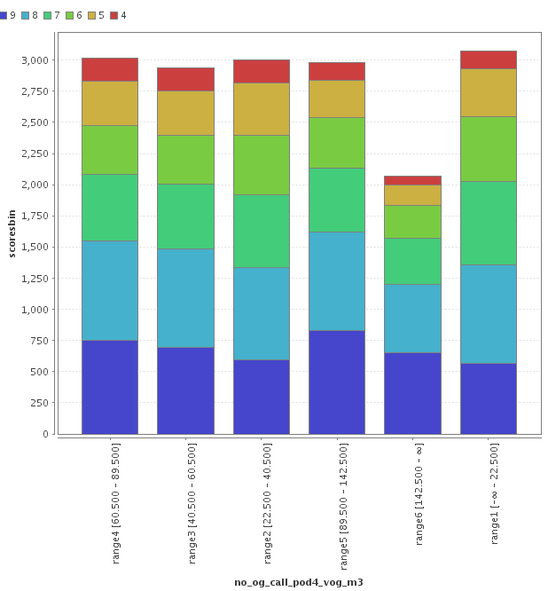
Training
Increasing Risk Rating of Churn
Step 8: Churn Motives (Cluster_0)
Cluster_0
Variable | Relative Importance
no_of_call_wfld_w_1_vog | 1
count_date_charge_m6 | 0.310128
no_ic_sms_wfld_w_1_sin | 0.221237
no_og_call_pod4_vog_m3 | 0.104748
no_og_sms_daytype_wd_sog_m6 | 0.101991
stddev_pop_basic_m2 | 0.098934
no_of_ic_call_wfld_w_1_vic | 0.096735
count_vas_basic_m2 | 0.081468
count_distinct_from_phone_number_sin_m6 | 0.080259
avg_basic_m6 | 0.079227
Discretized no_og_call_pod4_vog_m3 Segments

Slide 49
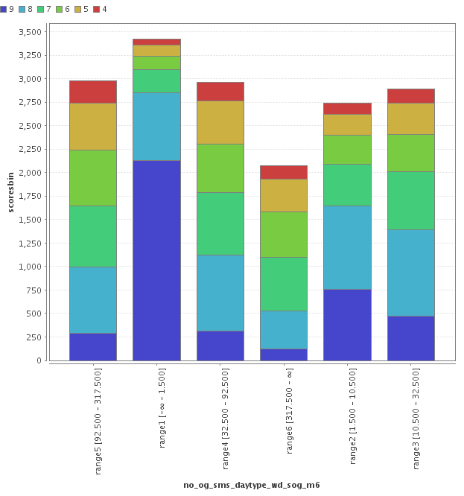
Training
Increasing Risk Rating of Churn
Step 8: Churn Motives (Cluster_0)
Cluster_0
Variable | Relative Importance
no_of_call_wfld_w_1_vog | 1
count_date_charge_m6 | 0.310128
no_ic_sms_wfld_w_1_sin | 0.221237
no_og_call_pod4_vog_m3 | 0.104748
no_og_sms_daytype_wd_sog_m6 | 0.101991
stddev_pop_basic_m2 | 0.098934
no_of_ic_call_wfld_w_1_vic | 0.096735
count_vas_basic_m2 | 0.081468
count_distinct_from_phone_number_sin_m6 | 0.080259
avg_basic_m6 | 0.079227
Discretized no_og_sms_daytype_wd_sog_m6 Segments

Slide 50
Understanding why subscribers churn?
Beyond the analysis of ‘selected’ attributes in previous slides, can go back to the full profile of the churning subs.
Cluster helps understand customer’s profile, can target churning subs from different cluster differently
However, not every ‘reason’ of churn can be identified, e.g. features like competitors have lower pricing, browsed competitor webpage, close friends switched telco, changing job, etc. are not captured in raw data and FG.

Slide 51
Scoring May-Oct’16 Subscribers
Can't score in hadoop – due to java version
Write reduced attribute set (only voice, sms, and gprs) to CSV, apply cluster model in-memory
Join cluster id back to overall table in hive, then split to 4 tables
Export 4 tables to csv, keeping only ‘selected’ attributes
32 for c0; 37 for c1; 15 for c2; 31 for c3
Apply models to score subs for each cluster.
Results save in hive – score_result_cluster0, 1, 2, 3
Ignore the predicted(churnoutcome) column. Use the selected score threshold to determine subscribers churn/no-churn

Slide 52
Project Takeaways
Established the methodology & processes for basic data filtering & cleansing, feature generation, feature selection, model training and validation, as well as future subs scoring
1270+ features from 12 sources, 4 models, 6+6 months – using 3 nodes, 8 man weeks
flexibility and agility on data integration and FG, provides comprehensive customer profiling – could contribute to upcoming Customer 360 initiative
Ad-hoc analytics processes can be created within minutes
Convenience to switch between in-Hadoop and in-memory processing, in a single platform, leveraging the best both worlds have to offer.
Cloudera tools – ease to manage the cluster

Slide 53
Challenges
Data understanding from scratch
Undocumented data relationships and data dictionary - including understanding of hundreds of attributes and interpretation of ‘abnormal’ values in attributes
Started with 12 data sources (1000+ generated features) right from the get-go, rather than progressively adding datasets
Spent lots of time on ETL, data checking, verification, waiting for process to complete, process modification due to data variation across months, e.g. topup, sms_in
Hardware limitations – 100% VIP subs and simultaneous processing within short period of time
Experienced cluster instability at different points
Difficulty to access archived data

Slide 54
Recommendations
Lots of model improvement/optimization possible
Enhance features – derive stronger, deeper level features (e.g. month to month changes in minutes used, or in ratio of voice call spending) should capture deeper representation of customer behavior rather than just solid figures
Feature selection – e.g. extreme, extra-comprehensive approach: brute force
Modeling – sample size, splits, model type, model params, decision threshold
* All involves more experiments and tests
Cost based learning (a.k.a. choose a good cutoff) - misclassifying a subs as “no churn” (lose revenue) is far more costly than misclassifying a subs as “churn” (small retainment mktg cost) - therefore should focus on precision for “no churn” class (minimize false negative) and recall for “churn” class (maximize true positive) – it’s ok to ‘overpredict’ churn
Involvement of business team which historically handled customer churn to provide domain inputs e.g. in terms of possible good features to derive for the churn model, or how to segment subscribers (by usage? By geographical region? Etc)

Slide 55
Recommendations - continued
Establish a well-sized Hadoop cluster running on recommended hardware architecture, to achieve the following
More data made available: better accuracy
Faster data preparation & model training process: hours to minutes
Cater for future use cases: data been prepared once and used many times, shorter time to market, greatly reduced repeatable efforts
Start building a customer 360 profile and continuously enriching it
Enforce security control and data governance practice, to achieve the following
Prevent any potential data leakage
Provide a secure environment as enterprise data vault, without sacrificing the flexibility to exchange the well-governed data assets across the entire organization

